Slide 1
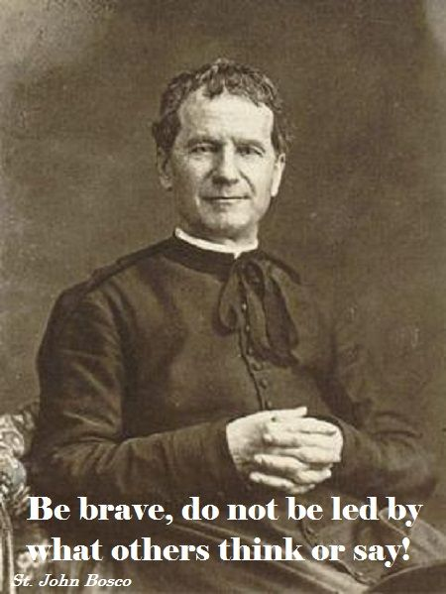
Saint John Bosco

Slide 2
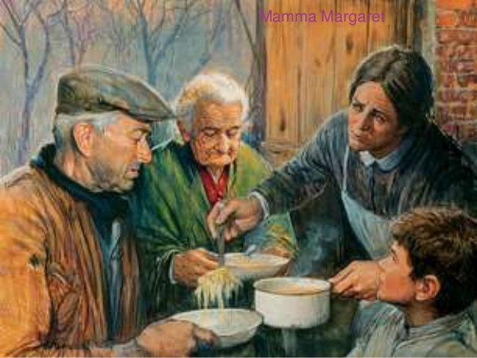
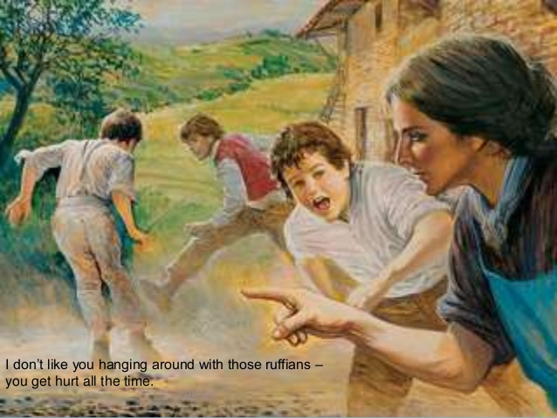
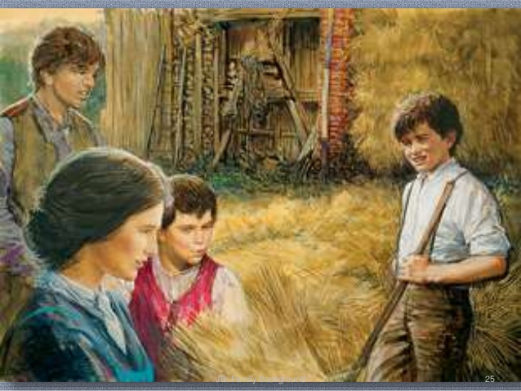
On August 15, 1815 a baby boy was born to Francis and Margaret Bosco. They named him Giovanni Bosco (John Bosco). When he was only 2 years old his father, Francis died. His mom would have to raise three boys on her own. John Bosco had two step-brothers, Joseph and Anthony. His mother taught the boys to love Jesus and Mary. They lived on a farm and she taught them the importance of hard work. The boys had house chores to do, firewood to cut, fields to plow and crops to look after. She would tell them that work was a privilege and they should do it with joy. They learned many important life lessons from their mom such as the importance of putting God in everything they did, being kind, and helping the poor.

Slide 3
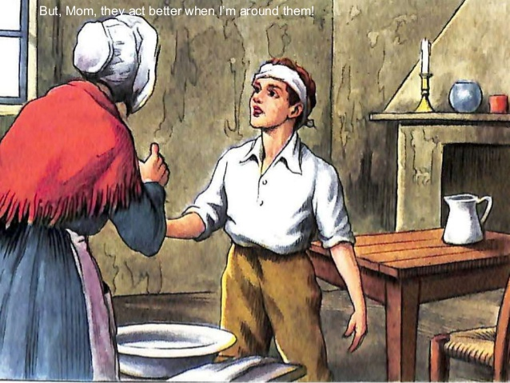
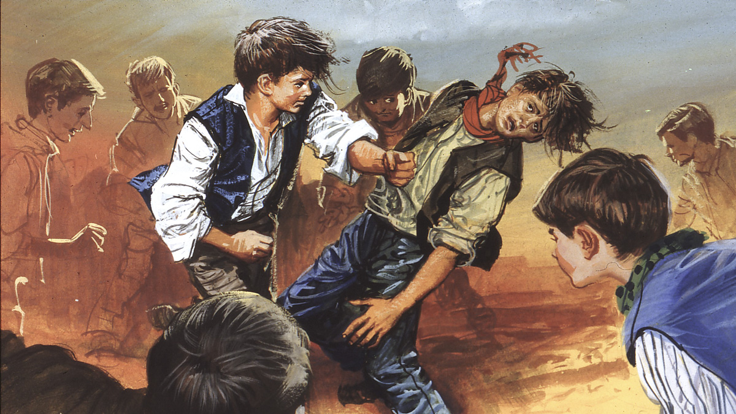
One day when John was still a little boy a priest came by and John ran up to greet him. The priest did not seem interested and brushed him off. This hurt John’s feelings and he told his mom that when he grew up, he would be a priest and always talk to children and do everything for them!
John would play with all the children in the nearby farms and often would come home a little scraped, beat up or with his shirts torn. His mother would tell him not to hang around those children, but John would say, “ Momma, they are good children, they just do not have a good mother like I do to teach them about Jesus and Mary”.

Slide 4
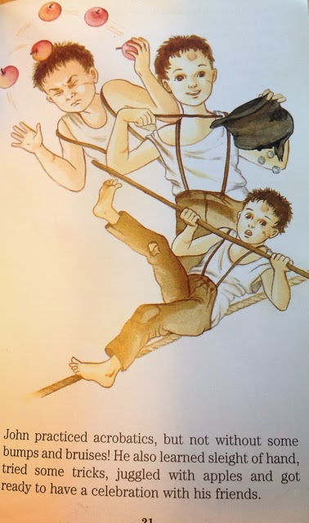
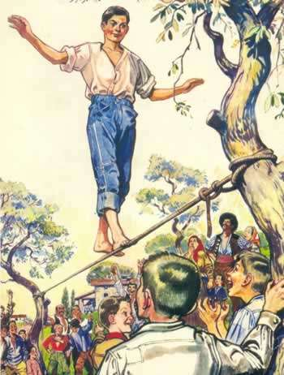
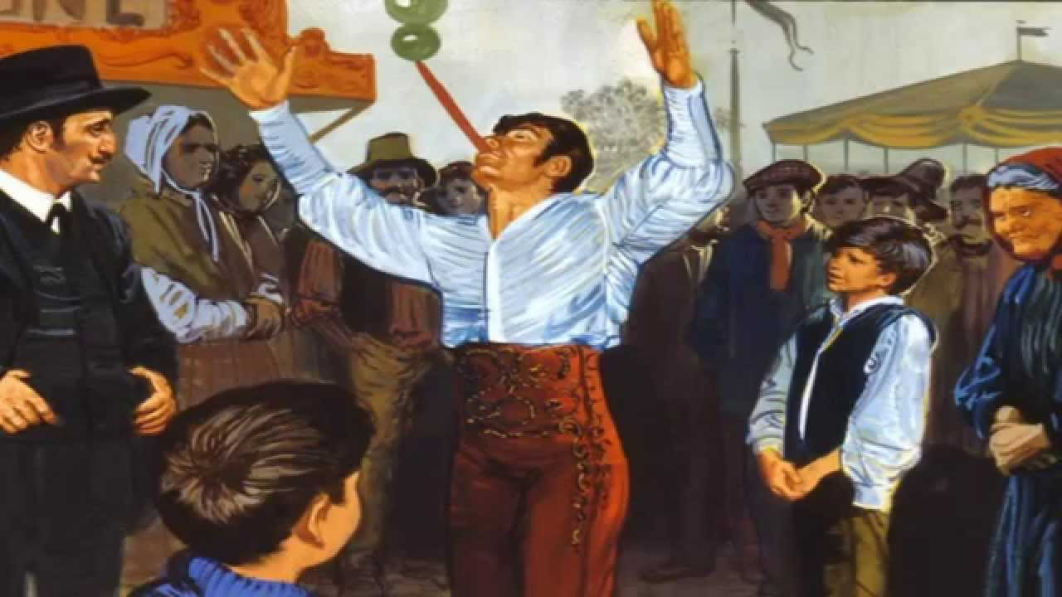
John was very intelligent and would go watch traveling shows. He learned magic tricks, juggling, and even how to walk on a tight rope!
He would then put on his own carnival shows for the local children and the admission price would be to pray a rosary together. If they really wanted to see his best tricks or special acrobatic presentations the children would have to tell him what the priest said at Sunday Mass.

Slide 5
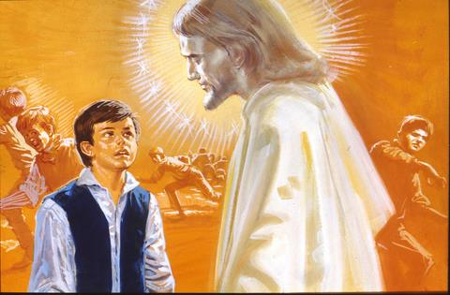
When he was only 9 years old, John had a dream. He found himself fighting a large crowd of rough boys who were kicking, punching and saying bad words to each other. He tried to stop by punching them and kicking them too, but they would not listen. Suddenly a Man appeared and said to him “not with punches will you help the boys, but with goodness and kindness.” Who are you? John asked.

Slide 6
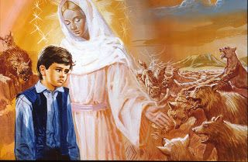
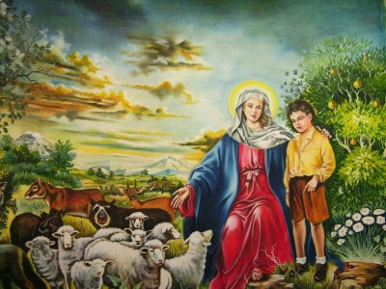
Then suddenly, a Woman appeared and putting her arms around him, she said, “Watch what I will do.” John looked and the boys changed into a pack of snarling, growling wild animals. The sight filled him with terror. Then the woman put out her hand. Then the beasts changed into gentle lambs playing and jumping around.
“But what does this all mean, I’m just a farm boy” and he burst into tears! The lady’s answer came to him and it stayed forever in his mind and heart. “This is the field of your work. Be humble, be steadfast, and be strong!” Then he woke up from his dream!

Slide 7
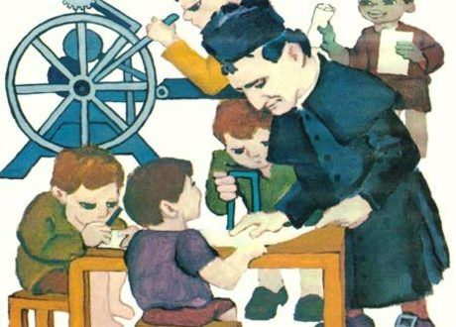
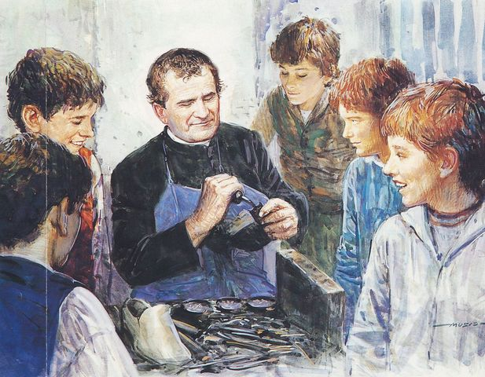
John now knew his vocation. He was to become a priest! To be a priest you have to study a lot and go to school. This was difficult because his brother Anthony felt that John should help out at the farm and not waste his time on books. For peace in the house, his mother allowed John to leave home and follow his vocation.
John worked very hard and was very smart. He had the gift of being able to listen to a speech once and memorize every word that was said. He finished four years of highschool in one year and one summer! And he worked at the same time to help his mother on the farm! He worked at many kinds of jobs and learned many skills. He worked as a blacksmith, tailor, waiter, baker, and shoemaker! All these skills came in handy later as he taught these skills to homeless boys to get them off the streets.

Slide 8
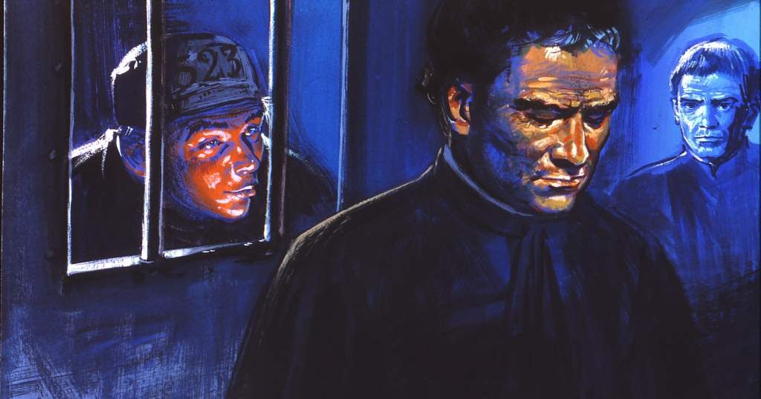
On July 5, 1841 John Bosco was ordained a priest. The title for “Father” in Italy is “Don,” so now he was called Don Bosco! He began to work even harder to do as much good as he could. He began to visit hospitals, orphanages and prisons. It was an experience at a local prison that SHOCKED him. He saw so many young boys that were in the prisons and sentenced to life! He needed to do something to prevent this! He was convinced that if these young boys had a good mentor or friend to give them good advice, this would not have happened to them.

Slide 9
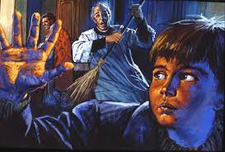
On December 8, 1841 while he was vesting for Mass, he heard a commotion. The sacristan was beating a boy with a broom and yelling at him to get out of the church! Don Bosco made him stop and asked why he was treating the boy so badly. The sacristan said that he had snuck in there to get out of the cold. Don Bosco began to talk to the boy and learned that he did not have parents and was homeless. He asked him what he did and the boy said he was a bricklayer. Don Bosco asked him if he knew how to whistle and the boy said “of course”. After that Don Bosco told the boy to come back every week and he would offer him some food and teach him how to say his prayers and to bring his friends.

Slide 10
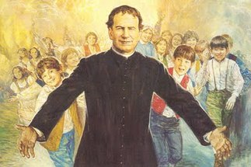
This is how Don Bosco began his ministry to the young! The number of boys soon grew to be more than 100! Don Bosco would gather the boys in a place he called the “ORATORY”. Here the boys could run, jump, play games, sing, learn a new skill, and most importantly learn their catechism and receive Jesus in the Eucharist and go to confession. This is how Don Bosco taught them to grow in holiness and become saints! Don Bosco founded The Society of Saint Francis De Sales or commonly called the Salesians of St. John Bosco.

Slide 11
Apply
St. John Bosco gave his life to help boys be happy and be good citizens in this world and in the next. You can do this too! Follow St. John Bosco’s advice:
Love Jesus in the Blessed Sacrament.
Love Mary and spread devotion to her.
Love and respect Our Holy Father. (POPE)

Slide 12
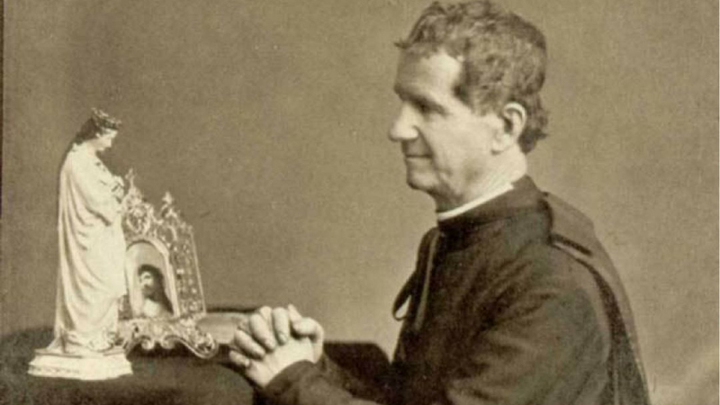
“If you want to see miracles in your life, TRUST in Mary.”
Don Bosco

Slide 13
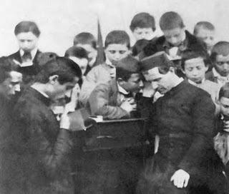
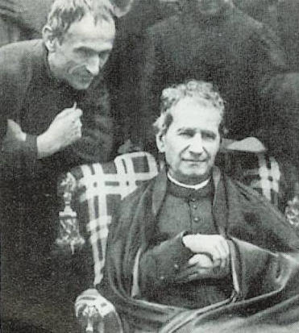
“Fly from bad companions as from the bite of a poisonous snake.”
St. John Bosco

Slide 14
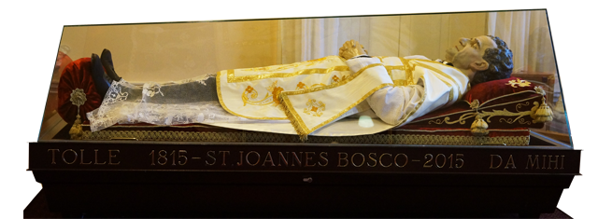
P
St. JOhn Bosco Pray for us!

Slide 15
#Hyperdoc Template created by Kelly Hilton Adapted by Sr. Ignacia Carrillo, FMA

